Slide 1

Memoryless Inference

Slide 2
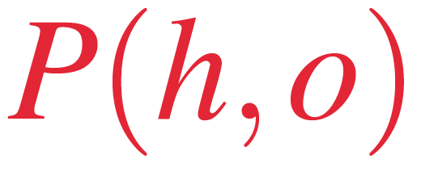

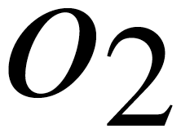
Amortized Inference

Slide 3
Learned Inference Model

Slide 9


Slide 10
Human
Believable
Unbelievable
Estimated posterior
True posterior

Slide 11
Model
Believable
Unbelievable
Estimated posterior
True posterior

Slide 12
A
B
C

